Slide 1
VICH GL1/GL2 - Validation of analytical procedures

Slide 2
Disclaimer
In the view of the presenter, these slides are consistent with relevant VICH guidelines and have been provided for training purposes only.
As always, the original Guideline should be used as the primary source of information for working with regulators.

Slide 3
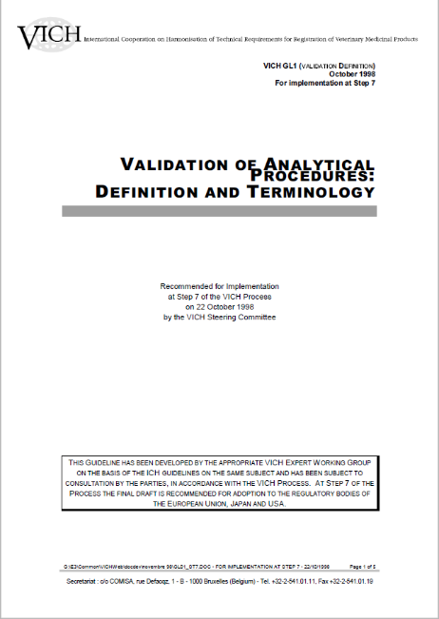
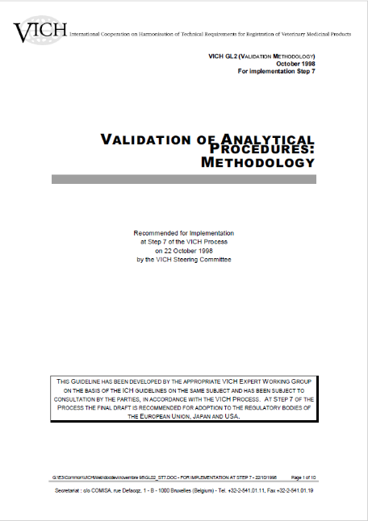
2 corresponding VICH guidelines
GL 1: Definition and Terminology
Defines the common vocabulary for analytical validation
Defines common types of tests: Identification, Impurities, Assay
Recommends Validation characteristics for these tests
GL 2: Methodology
Describes
How the Validation should be performed
Recommends which data should be generated, interpreted and presented

Slide 4
Scope of guidelines
In Scope
  Identification tests.
  Quantitative tests for impurities’ content.
  Limit tests for the control of impurities.
  Quantitative tests of the active moiety in samples of drug substance or drug product or other selected component(s) in the drug product.
Currently partially in Scope:
  Tests for biological products
  „Due to their complex nature, analytical procedures for biological and biotechnological products in some cases may be approached differently than in this
  document.” (GL2)
  Currently out of Scope
  Properties Tests (e.g. Particle Size)
  Drug performance Tests (e.g. Dissolution – vessel part)
  „Validation of these additional analytical procedures is equally important to those listed herein and may be addressed in subsequent documents” (GL1)

Slide 5
Analytical method validation - Definition
What is Analytical Method Validation:
  “The objective of validation of an analytical procedure
  is to demonstrate that the it is suitable for its intended purpose.”
VICH Guideline GL1
  Basic requirement to ensure quality and reliability of analytical results.
  Well-documented experimental studies.
  Validation should adress the performance of the analytical procedure under conditions of routine use
  Suitability is strongly connected with both the requirements and the design of the individual analytical procedure.
Notes:
Validation is, of course, a basic requirement to ensure quality and reliability of the results for analytical application.
What does suitablity mean?
The suitability of an analytical prodedure is primarily determined by the requirements of the given test item, and secondly by its design. Usually, the requirements are defined by the acceptance limits of the specification.

Slide 6
Analytical method validation - Definition
What is not Analytical Method Validation:
  Calibration:
    Standardization of a measuring instrument against an accurate standard.
    The act of checking or adjusting the accuracy of a measuring instrument by comparison with a standard.
  System Suitability Tests:
    Test to ensure that the system is working properly at the time of analysis.
    Recommended as component of any analytical procedure.
    Parameters and acceptance criteria are based on the type of analysis and the intended use of the procedure.
Notes:
The accuracy and precision of HPLC data collected begin with a well-behaved chromatographic system.
The system suitability test and specifications are parameters that provide assisstance in achieving this purpose.
System suitability criteria are limits applied to various analytical procedures.
They are designed to ensure their adequate performance.
These criteria are to be fulfilled before and / or during the analysis of the samples.
System suitability tests are therefore to be included in the written procedure.

Slide 7
Analytical procedure - Definition
“The analytical procedure refers to the way of performing the analysis. It should describe in detail the steps necessary to perform each analytical test” (GL1)
Validation activities typically include the complete analytical procedure:
Sampling
reference standard
reagents preparations
use of the apparatus
generation of the calibration curve
use of the formulae for the calculation
Sample & Reagent Preparation
Analysis
Data Evaluation Reporting

Slide 8
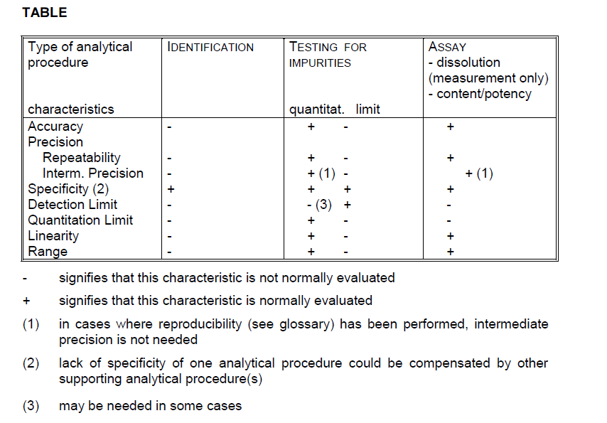
Validation Characteristics

Slide 9

Specificity - Definition
“Specificity is the ability to assess unequivocally the analyze in the presence of components which may be expected to be present.” (GL1)
  ex. impurities, degradants, matrix components
VICH guidelines are using Specificity and Selectivity interchangeably in contradiction to IUPAC*:
  “A specific reaction or test is one that occurs only with the substance of interest, while a selective reaction or test is one that can occur with other substances but exhibits a degree of preference for the substance of interest”
  *Selectivity in analytical chemistry (IUPAC Recommendations 2001), J. Vessman, R.I. Stefan, J.F. Van Staden, K. Danzer, W. Lindner, D.T. Burns, A. Fajgelj, and H. M, Pure Appl. Chem., Vol. 73, No. 8, pp. 1381–1386, 2001.
Notes:
Specificity is the ability of an analytical method to measure the analyte free from interference due to other components.
Typically this might include impurities, degradants, matrix, etc..
Lack of specificity of an individual procedure may be compensated by other supporting analytical procedure(s).
There has been some controversial discussion about the terminology for this validation characteristic. In contrast to ICH, most other analytical organizations define this as selectivity, whereas specificity is regarded in an absolute sense, as the ultimate degree of selectivity.
Despite this controversy, there is a broad agreement that specificity / selectivity is the critical basis of each analytical procedure.
Without a sufficient selectivity, all other performance parameters are meaningless.
In order to remain a consitent terminology, specificity is used as a general term for the validation characteristic, whereas selectivity describes its qualitative grade.

Slide 10
Specificity – Sources of interference
Potential API interferences:
  Starting Materials
  Synthesis Intermediates
  Enantiomers / Isomers
  Salt Forming agents
  Structurally Similar Compounds
Potential DP interferences:
  Excipients
  Drug Substance Degradants
  Drug Product Degradants
  Impurities /
  Related Substances
  Packaging Extractables

Slide 11
Demonstration of Specificty
Specificity is the „hallmark“ of any analytical procedure.
Required for identity tests, assay and impurity tests.
For identity tests, specificity is demonstrated by:
  Comparison with known reference standards (positive confirmation),
  e.g. for HPLC with Diode-Array-Detector: Retention time, UV-spectrum
  Discrimination between compounds closely related in structure.
  For drug products, excipients should not interfere with API.
For Assay and Impurities (Chromatographic methods), specificity is demonstrated by:
  Resolution of peaks
  Peak purity of main component (diode array or MS)
  Verification of the results by an independent, secondary method
  (e.g. TLC, CE, GC, NIR, Raman, etc.).
Notes:
Identity method should be able to discriminate between compounds closely related in structure.
Specificity is confirmed by obtaining negative results for samples spiked with related compounds and positive results for samples containing the analyte.
The choice of potential interfering substances should be based on sensible scientific judgement considering substances that could likely occur.
In case of chromatographic assay and impurity methods, available impurities/degradands can be spiked at appropriate levels to the corresponding matrix or else degraded samples can be used.
For assay, it can be demonstrated that the result is unaffected by the spiked impurities / excipients.
Impurities should be separated individually and / or from the matrix components.
In the case of chromatographic separations, resultion factors should be obtained for critical separations.
Specificity can also be demonstrated by verfication of the results by a second, independent analytical procedure (orthogonal method).
Test for peak homogeneity, for example, by diode array detection or mass spectrometry are recommended.

Slide 12

Specificity - Impurities
VICH requirements for specificity testing:
If impurity/degradation product reference materials are available:
  For Assay:
  Spike impurities and/or excipients → demonstrate that the assay results is unaffected by the presence of these materials
  (e.g. by comparison with the assay result of un-spiked samples)
For impurities:
  Spike with appropriate levels of impurities and/or excipients → demonstrate the separation of these impurities individually and/or from other components in the sample matrix.
If impurity/degradation product reference materials are not available:
  Use relevant stressed samples (light, heat, humidity, pH, oxidation, etc..)
Typically, forced degradation experiments with the drug substance and drug product (including excipients) are required. Omission of data is rare (e.g. with well known established substances with clear degradation pathways)

Slide 13
Analytical Method Validation – Validation parameters - Specificity
Forced decomposition testing:
WHAT
  Acid / Base Hydrolysis
  Oxidation
  Thermal Degradation
  Photolysis
FOR
  Drug Substance
  Drug Product
  Placebo (Matrix)

Slide 14
Precision and Accuracy - Definitions
Precision – Definition:
  „The precision of an analytical procedure expresses the closeness of agreement between series of measurements (degree of scatter) obtained from multiple samplings of the same homogenous sample under prescribed conditions (GL1).“
Accuracy – Definition:
  „The accuracy of an analytical procedure expresses the closeness of agreement between the value which is accepted either as a conventional true value or an accepted reference value and the value found (GL1).“

Slide 15
Accuracy versus Precision
x
x
x
x
x
x
x
x
x
x
x
x
Accurate + Precise
Accurate but not precise
x
x
x
x
x
x
x
x
x
x
x
Precise but not accurate
None of each

Slide 16
Precision - Methodology
3 levels of precision:
  Repeatability
  Intermediate Precision
  Reproducibility
Experimental recommendations in GL1:
  Use of homogenous, authentic samples (if possible).
  Apply the whole analytical procedure (as described in the test method) including sample preparation, analysis, data integration and assessment.

Slide 17

Repeatability - Definition
“Repeatability expresses the precision under the same operating conditions over a short interval of time. Repeatability is also termed intra-assay precision” (GL1)
  Analytical variability under the same operating conditions
  Over a short time-interval
  Minimum of 6 determinations at the 100% level or
  Minimum of 9 determinations covering the specified range
  (e.g. 3 concentration levels x 3 replicates each)

Slide 18


Intermediate precision - Definition
“Intermediate precision expresses within-laboratories variations: different days, different analysts, different equipment, etc..” (GL1)
  Includes influences of additional random effects
  in the same laboratory (day-to-day variability)
  Initial estimate for the long-term variability
  Relevant factors as e.g. operators, instruments, days
  should be varied.
  The use of an experimental design (matrix) is encouraged.
Stability studies are very often a good source to estimate the intermediate precision additionally as typically operators, reagents or instruments vary over a longer time period.

Slide 19
Reproducibility - Definition
“Expresses the precision between laboratories (collaborative studies, usually applied to standardization of methodology)” (GL1)
  Variability between different laboratories
  Inter-laboratory trials (collaborative trials) varying further parameters
  Additional contributions due to differences in knowledge, experience, equipment etc.. among the participating laboratories
  Important, if the method is applied at different sites
Method transfer experiments are additionally a good source to estimate the reproducibility of an analytical procedure
Notes:
The basic setup for the experimental design must contain
- Experiments at 6 different time points. 6 different days are preferable.
- 2 Operators
- 2 analytical instruments
In addition, one or more analytical conditions which are expected to influence the result should be varied, such as the HPLC column batch, batch of a used chemical, different test cell and so on.
In principle, the additional conditions can be selected as those points which naturally vary during a long term operation of the test method, for example consumables.
It is recommended to perform 2 measurements per experiment. This gives additional information about the repeatability of the method.

Slide 20
Precision – Levels of Precision determination
Example: HPLC
Reproducibility
Time
(long-term)
Collaborative trials
Instrument
Intermediate Precision
Operator
Column
Sample preparation
Reagents
Day
Repeatability
Weighing
Dilution
Extraction
Integration
Injection variability
Peak separation
System Precision
Detection
Flow variations

Slide 21
Simple Experimental design – HPLC example
  Approach often used in Japan, based on Analysis of Variance (ANOVA)
  Enables to measure precision and intermediate precision in one experiment
  Other Multivariate experimental and statistical approaches can be used alternatively
Date 1 | Date 2 | Date 3 | Date 4 | Date 5 | Date 6
Operator1 | Operator1 | Operator2 | Operator2 | Operator1 | Operator2
Instrument 1 | Instrument 2 | Instrument 1 | Instrument 2 | Instrument 1 | Instrument 2
Column 1 | Column 2 | Column 1 | Column 2 | Column 1 | Column 2
Rep. 1,2 | Rep. 3,4 | Rep. 5,6 | Rep. 7,8 | Rep.9,10 | Rep. 11,12
Notes:
The basic setup for the experimental design must contain
- Experiments at 6 different time points. 6 different days are preferable.
- 2 Operators
- 2 analytical instruments
In addition, one or more analytical conditions which are expected to influence the result should be varied, such as the HPLC column batch, batch of a used chemical, different test cell and so on.
In principle, the additional conditions can be selected as those points which naturally vary during a long term operation of the test method, for example consumables.
It is recommended to perform 2 measurements per experiment. This gives additional information about the repeatability of the method.

Slide 22
Accuracy - Methodology
Accuracy can be demonstrated by the following approaches:
  Inferred from precision, linearity and specificity,
  Comparison of the results with those of a well characterized, independent procedure,
  Application of reference material.
  Recovery experiments:
    - Recovery of drug substance spiked to placebo or drug product.
    - Recovery of the impurity spiked to drug substance or drug product.

Slide 23
Accuracy - Experiments
Experimental Recommendations :
  Recovery must test the complete analytical procedure (including sample preparation) for each determination
  To be established across the specified range if the analytical procedure.
  Minimum of 9 determinations over a minimum of
  3 concentration levels
    e.g. 3 concentration levels x 3 replicates each
  Reported as % recovery of known amount added together with the confidence intervals (95% confidence level).

Slide 24
Linearity - Definition
Linearity – Definition:
  “The linearity of an analytical procedure is the ability (within a given range) to obtain test results which are directly proportional to the concentration of the analyze in the sample (ICH).”
Linearity might be demonstrated:
  Directly on the analyze (independent solutions),
  On spiked samples
  At least 5 concentration levels over the whole concentration range
Notes:
Specificity is the ability of an analytical method to measure the analyte free from interference due to other components.
Typically this might include impurities, degradants, matrix, etc..

Slide 25
Linearity - Evaluation
Linearity should be evaluated by:
  Visual inspection of plot of signals vs. analyze concentration
  Appropriate statistical methods:
  Linear regression (y = ax + b)
  Correlation coefficient, y-intercept (b), slope (a), residual sum of squares
Linearity relationship between analyze concentration and test results is preferable, but not essential:
” Some analytical procedures, such as immunoassays, do not demonstrate linearity after any transformation. In this case, the analytical response should be described by an appropriate function of the concentration (amount) of an analyze in a sample” (GL2)

Slide 26
Range - Definition
  Range – Definition:
  „The range of an analytical procedure is the interval between upper and lower concentration of analyze in the sample for which it has been demonstrated that the analytical procedure has a suitable level of precision, accuracy and linearity (GL1).“
  Established by confirming that the method provides acceptable degree of Linearity, Accuracy and Precision
Response
Linear range
Slope = sensitivity
LOQ
e.g. RSD > 10%, S/N > 20
LOD
e.g. S/N > 3
Intercept
Amount

Slide 27
Range – Recommended Ranges
The specific range is dependent on the intended application of the procedure
Analytical procedure | Recommend minimum range
Assay | 80 – 120% test concentration
Content uniformity | 70 – 130% test concentration
Dissolution | + 20% upper / -20% lower specification limit
Impurities
in drug substance | GL10 Reporting level – 120% of specification
in drug product | GL 11 Reporting level – 120% of specification
Highly potent/toxic impurities | control level – 120% of specification

Slide 28
LOD/LOQ - Definition
Limit of detection (LOD) / Limit of quantitation (LOQ)
Limit of detection (LOD):
  „... lowest amount of analyze in a sample which can be detected but not necessarily quantified as an exact value (GL1).“
Limit of quantification (LOQ):
  „... lowest concentration of analyze in a sample which can be quantitatively determined with suitable precision and accuracy (GL1).“
LOQ must be less than or equal to the reporting threshold!

Slide 29
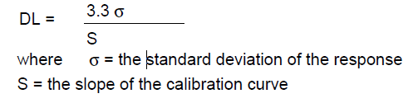
LOD/LOQ – Determination methods
Limit of detection (LOD) / Limit of quantitation (LOQ)
Various approaches can be applied:
Visual definition (for non-instrumental methods)
Calculation from the signal-to-noise ratio
  Typically 3:1 or 2:1 for LOD and 10:1 for LOQ
Based on the standard deviation and the response of the slope
“Approaches other than those listed below may be acceptable” (GL2), e.g. repeatability of signal at LOQ levels

Slide 30
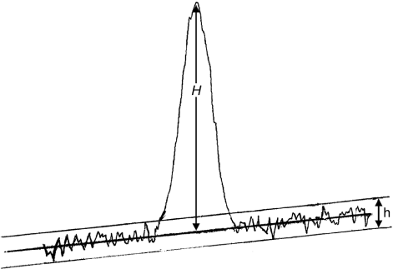
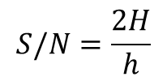
LOD/LOQ – Example Signal-to-Noise
Limit of detection (LOD) / Limit of quantitation (LOQ)
Example: Signal-to-noise ratio method according to Ph. Eur. 2.2.46:
$$S/N=\frac{2H}{h}$$
H | = | height of the peak
h | = | range of the noise in a chromatogram
Baseline extrapolated to at least 5 x width at half height
Notes:
For a practically relevant LOQ determination, impurities should be spiked to the drug substance or drug product, i.e. The respective matrix.
If properly applied, all determination approaches lead to comparable and correct results, therefore the most pragmatic approach can be chosen.
The validity of the established LOQ should be routinely confirmed within the system suitability test.

Slide 31
Robustness - Definition
Robustness
Robustness – Definition:
  „The robustness of an analytical procedure is a measure of its capacity to remain unaffected by small, deliberate variations in method parameters and provides an indication of its reliability during normal stage (GL1).“
Evaluation of robustness within method development (prior to Analytical Method Validation)
Robustness experiments should show reliability of parameters
Robustness experiments should drive the need for System Suitability Testing (SST)

Slide 32
Robustness – Typical Variation Examples
General:
  Stability of analytical solutions, extraction time
  Liquid chromatography:
  Variations of pH in a mobile phase, mobile phase composition, different columns (different lots and/or suppliers), temperature, flow rate.
  Gas-chromatography:
  Different columns , variations of temperature and flow rate
Planning of robustness experiments should include prior knowledge of potential parameters impacting the performance of the analytical procedure and variation experiments beyond examples may be required

Slide 33
System Suitability Test - Definition
  “System suitability testing is an integral part of many analytical procedures. The tests are based on the concept that the equipment, electronics, analytical operations and samples to be analyzed constitute an integral system that can be evaluated as such” (GL2)
  SST are specific for the analytical procedure and technology
  Example SST criteria may be found in Pharmacopoeias
System suitability test
Performed before or during each analytical test
Ensuring suitability of test during regular operations
vs.
Validation
Performed initially or after a product/procedure change
Ensuring suitability with intended purpose
SST are typically either self-test components of the analytical technology used or a subset of validation experiments (e.g. repeatability) as described in VICH GL2.

Slide 34
Case Studies for re-validation after changes of product requirements or analytical procedure

Slide 35
Re-validation after a change
Revalidation may be necessary in the following circumstances:
  Changes in the synthesis of the drug substance;
  Changes in the composition of the finished product;
  Changes in the analytical procedure
The degree of revalidation required depends on the nature of the changes. Certain other changes may require validation as well
Define and document change
yes
Change fits the method scope, parameters and limits?
no
Perform partial or full revalidation
Define and perform system suitability testing

Slide 36

Impact of change
Case Study 1 – New Impurity isolated or synthesized
Case: The structure of a new impurity was elucidated and the compound was synthesized in sufficient amounts
  Impact on Validation status ?
  Impact on Specs?
  Impact on previously
  generated results?

Slide 37
Impact of specification changes
Case Study 1 – New Impurity isolated or synthesized
Selectivity To be demonstrated via spiking experiment
To be demonstrated via spiking experiment
LOD/LOQ To be verified with new related substance
To be verified with new related substance
Linearity/ New determination with new related substance needed
Range
New determination with new related substance needed
Accuracy New spiking experiment required
New spiking experiment required

Slide 38
Impact of changes
Case Study 2 – Specifications tightened or widened
Case: The specification for a related substance is widened or tightened
Impact on Validation status ?

Slide 39
Impact of specification limits on Range/Linearity/Accuracy
Spec widened:
Range must still cover Rep. Limit -at least 120% of spec for Linerarity/Accuracy
Spec Narrowed
Linearity results may not be precise in the low range, if insufficient number of data points in the range
Best practice:
Have more than 5 points and more than 3 accuracy levels to cover all the discussed or possible specification ranges!
LOQ-at least 120% of specs with n≥5
Old Range
New wider specification limit/range

